Slide 1

Digital Electronics and Computer Architecture
SCHOOL OF COMPUTER ENGINEERING AND TECHNOLOGY

Slide 2

Digital Electronics and Computer Architecture
Course Objectives:
By participating in and understanding all facets of this Course a student will be able:
To learn number systems, Boolean algebra and to introduce the concepts of digital logic families.
To develop skills for design and implementation of combinational logic circuits.
To develop skills for design and implementation of sequential circuits
To understand the functions, characteristics of various components of computer, instruction set, addressing mode of computer architecture and Pipeline Hazards
To acquire the knowledge of Control unit architecture and Memory Organization

Slide 3

Digital Electronics and Computer Architecture
Course Outcomes:
On completion of course, students will be able to
Identify and use the basic logic gates and solve logic equations with various reduction techniques of digital logic circuits.
Design and implement combinational logic circuits
Design and implement sequential logic circuits
Recognize the functions and organization of various blocks of CPU. Describe CPU instruction characteristics used in Pipelining concept and its relevance with Processor’s performance.
Demonstrate computer architecture concepts related control unit and memory

Slide 4

Syllabus
Module 1 Computer Arithmetic:
Introduction to digital logic families, Introduction to Number System and Codes, Sign Magnitude representation, 1’s and 2’s complement, Binary Arithmetic: Addition, Subtraction of signed numbers, multiplication of positive numbers, Integer Arithmetic, Floating point representation and operations – IEEE standard, Boolean Algebra, Logic Gates, Minimization of logic functions using K map (SOP and POS)
Module 2 Combinational Logic Design:
Design examples: Arithmetic circuits, Comparator, Code converters, Parity generators and checkers, Arithmetic and Logic Unit, design of adder and fast adder, look ahead carry generator, Implementation of SOP and POS using MUX, DMUX, DECODER.
Module 3 Sequential Logic Design:
1-bit Memory Cell, Flip flops, Conversion of flip flops, Design of ripple counters and synchronous counters, Modulus of the counter, Sequence generator, Lock out condition. Shift registers, Applications of Shift registers (ring and twisted ring counters), Moore and Mealy Models- State diagram, State Tables and Design Procedure, Sequence detector.

Slide 5
Syllabus
Module 4 Fundamental of Computer Architectures:
Structure and Function, basic operational concepts of bus structures Memory locations and addresses functions. Types of computer units (CPU, Memory, I/O, System Bus), Von Neumann & Harvard architecture, Key characteristics of RISC & CISC.
ALU: Multiplication – Block diagram, Hardware implementation of unsigned binary and signed number, Booth’s Algorithm, Division Algorithms (Unsigned Binary).
Processor organization, Register organization- user visible registers, control and status registers-Case Study 8086. Instruction Cycle- The machine cycle and Data flow. Types of operands, Types of operations, Types of instructions, Addressing modes and Instruction Formats- instruction length, allocation of bits, variable length instructions instruction formats - Case Study- 8086. Processor and Instruction Pipelining, Pipeline Performance, Pipeline Hazards - Structural, Data, Control.

Slide 6
Syllabus
Module 5 Control Unit and Memory System:
Hardwired control, Micro-programmed control- micro instructions, micro-program sequencing, wide branch addressing, microinstruction with next address field, prefetching microinstructions and emulation.
Memory hierarchy, characteristics, Cache Memory- Cache memory principles, Elements of cache design- cache address, size, mapping functions, replacement algorithms, write policy, line size, number of cache, one level and two level cache, performance characteristics of two level cache- locality & operations, main memory and secondary storage. Pentium IV cache organization

Slide 7
Syllabus
List of Assignments:
Design and Implement Code Converters using logic gates
Design and Implement Combinational Logic Design using MUX/Decoder ICs
Design and Implement asynchronous counter using JK- Flip flop.
Design and Implement MOD-N asynchronous counter using JK- Flip flop /IC7490.
Design and implement Synchronous Counter
Design of a sequence detector
Write an assembly language program (ALP) to display 2-digit and 4-digit hex numbers using 64- bit assembly language programming
Write an assembly language program (ALP) to accept 2-digit and 4-digit hex numbers user input using 64- bit assembly language programming.
Write an assembly language program (ALP) to implement addition and subtraction of 8-bit numbers (Using user input, macro and procedure).
Write an ALP to perform basic string operations. (length and Reverse)

Slide 8
Module 1 Computer Arithmetic
Introduction to digital logic families,
Introduction to Number System and Codes,
Sign Magnitude representation, 1’s and 2’s complement,
Binary Arithmetic: Addition, Subtraction of signed numbers, multiplication of positive numbers, Integer Arithmetic,
Floating point representation and operations – IEEE standard, Boolean Algebra, Logic Gates, Minimization of logic functions using K map (SOP and POS)

Slide 9
Text book soft copy available

Slide 10
Digital and Analog Quantities
For many years, applications of digital electronics were limited to computer systems.
Digital Technology have wide range of applications
Television
Communication systems
Radar
Navigation
Military Systems
Medical Instrumentations
Industrial Process Control
Consumer electronics etc.
Electronics circuits can be divided into two broad categories
Digital
Analog

Slide 11
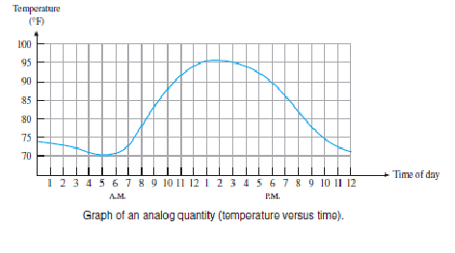
Digital and Analog Quantities
Analog: is one having continuous values
Digital: is one having discrete set of values
Example: Air temperature changes over continuous range of values
Analog Signal

Slide 12
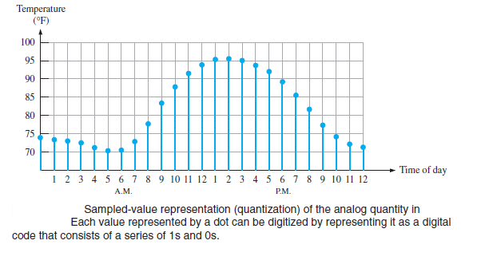
Digital Code

Slide 13
Advantages of Digital Signals
Data transmission is more effective and reliable
Digital data has a great advantage when storage is necessary
Digital data is more accurate and precise
Its ripple free or noise free

Slide 14
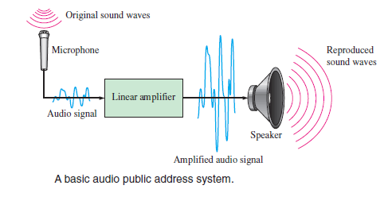
Analog Systems

Slide 15
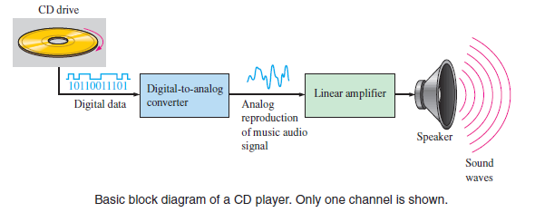
A System Using Analog and Digital Methods

Slide 16
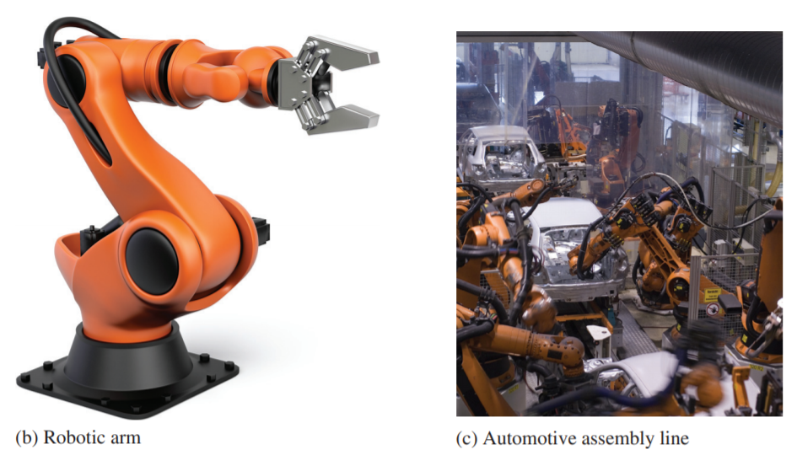
Mechatronics
The interdisciplinary field that comprises both mechanical and electronic components is known as mechatronics
Both digital and analog electronics are used in the control of various mechanical systems.

Slide 17
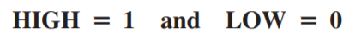
Digital Electronics
It uses Binary Digits 0 and 1
Each of the two digits in the binary system, 1 and 0, is called a bit, Two different voltage levels are used to represent the two bits.
1 - is represented by the higher voltage, which will be referred as a HIGH,
0 - is represented by the lower voltage level, which will be referred as a LOW.
This is called positive logic and will be used throughout the topic.

Slide 18
Number System and Binary Codes

Slide 19
Number System and Binary Codes
Number systems
Representation of unsigned and signed integers
Fixed-point representation of real numbers
Floating-point representation of real numbers
Binary representation
Codes and their conversions
Binary arithmetic

Slide 20
Number Systems
Decimal
1234₁₀ = (1 × 10³) + (2 × 10²) + (3 × 10¹) + (4 × 10⁰)
Binary
1101₂ = (1 × 2³) + (1 × 2²) + (0 × 2¹) + (1 × 2⁰)
Octal
123₈ = (1 × 8²) + (2 × 8¹) + (3 × 8⁰)
Hexadecimal
123₁₆ = (1 × 16²) + (2 × 16¹) + (3 × 16⁰)
here we need 16 characters – 0,1,2,3,4,5,6,7,8,9,A,B,C,D,E,F

Slide 21
Binary number into Decimal
Convert the given binary number into decimal equivalent number
(100010)₂=0×2⁰+1×2¹+0×2²+0×2³+0×2⁴+1×2⁵
=0+2+0+0+0+32
=(34)₁₀
2. (0.1011)₂=1×2⁻¹+0×2⁻²+1×2⁻³+1×2⁻⁴
=0.5+0+0.125+0.0625
=(0.6875)₁₀
3. (10101.011)₂
Integer part: (10101)₂=1×2⁰+0×2¹+1×2²+0×2³+1×2⁴
=1+0+4+0+16 = (21)₁₀
Decimal part: (0.011)₂=0×2⁻¹+1×2⁻²+1×2⁻³
= (0.375)₁₀
= (21.375)₁₀

Slide 22
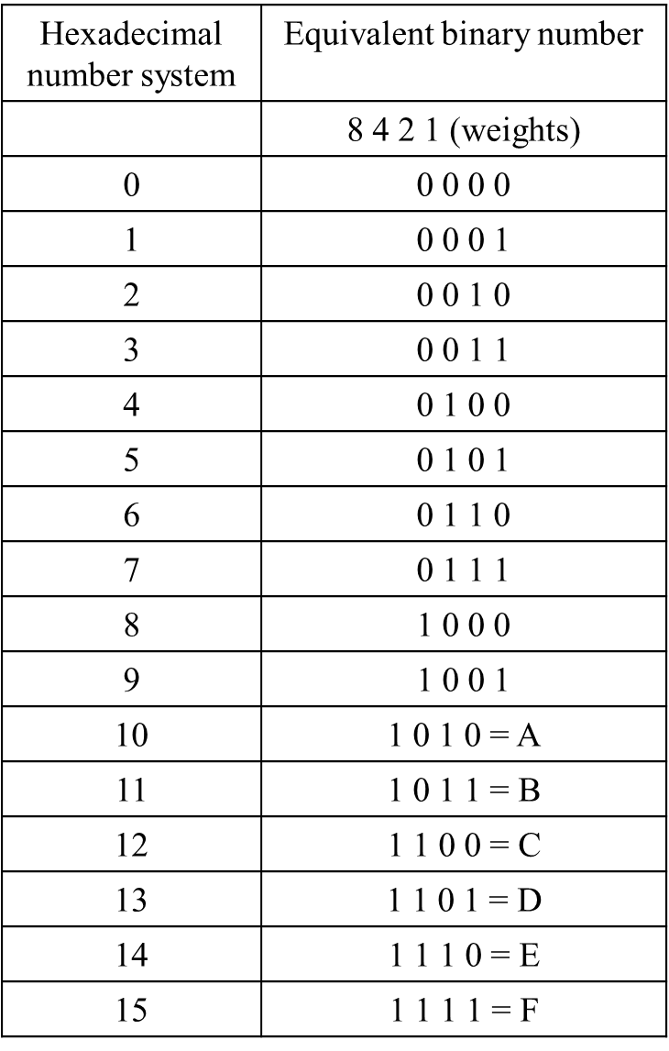
Hexadecimal Number System
Hexadecimal Number System:
The hexadecimal number system has base 16. It has 16 distinct digit symbols. It uses the digits 0-9 & letters A,B,C,D,E,F as 16 digit symbols.
Hexadecimal to Binary Conversion
Hexadecimal C 3
Binary 1100 0011
Binary to Hexadecimal Conversion
Binary 1110 1010
Hexadecimal E A

Slide 23
Hexadecimal Number System
DECIMAL TO HEXADECIMAL CONVERSION
Divide by 16 Process
Decimal #
47 ÷ 16 = 2 remainder 15
2 ÷ 16 = 0 remainder 2
2 F
HEXADECIMAL NUMBER INTO DECIMAL NUMBER SYSTEM
1. (2B8D.E2)16= 2×16³+11×16²+8×16¹+13×16⁰ +14×16⁻¹+2×16⁻²
= 8192+2816+128+13+0.875+0.0078125
= (11149.88281)₁₀
(269)₁₆= ? Answer: (617)₁₀

Slide 24
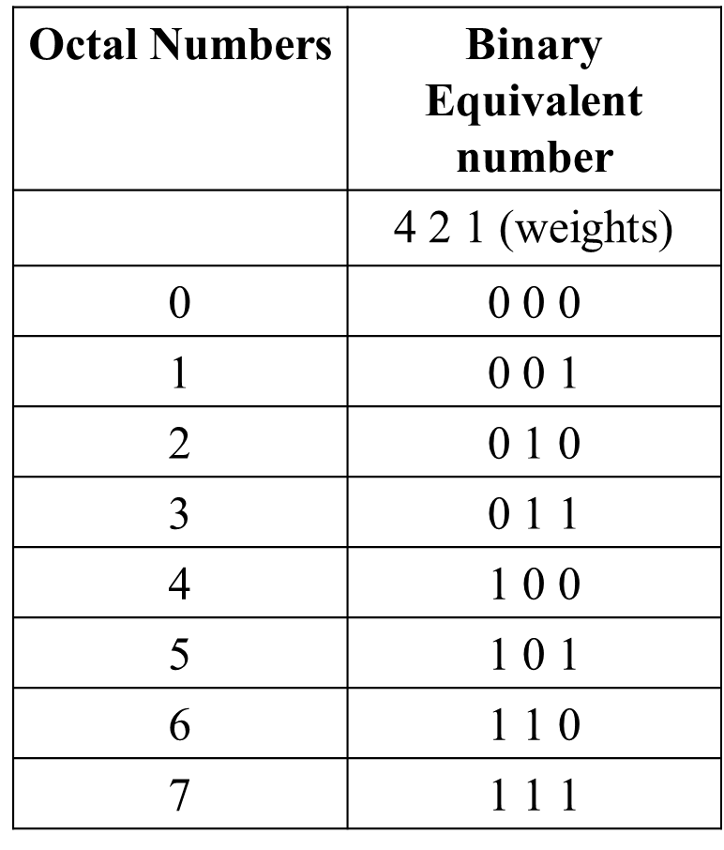
Octal Number System
A number system that uses 8 digit (0-7) is
called an octal number system. It has base 8.
Octal number system into Binary number system:
(7423.245)₈
7 | 4 | 2 | 3 | . | 2 | 4 | 5
111 | 100 | 010 | 011 | . | 010 | 100 | 101
Conversion from Binary number system to Octal number system:
(11101101110.11111)₂
011 | 101 | 101 | 110 | . | 111 | 110
3 | 5 | 5 | 6 | . | 7 | 6

Slide 25
Octal Number System
Octal to Decimal Conversion
Multiplying each Octal digit by its positional weight
(314)₈ = 3×8³+3×8²+1×8¹+4×8⁰ = 192 + 8 + 4
= (204)₁₀
Decimal to Octal Conversion
Repeated division or double dabble method
(1375)₁₀ = (2537) ₈
_{remainder}
8 | 1375
8 | 171 | 7
8 | 21 | 3
 | 2 | 5
 |  | 2
MSB

Slide 26

Hexadecimal number system to Octal number system:
First write down the 4 bit binary equivalent of hexadecimal digit and then rearranging into group of three bit each.
(2AB.9) ₁₆ = (?)₈
Hexadecimal equivalent | 2 A B . 9 0010 1010 1011 . 1001
Octal equivalent | 001 010 101 011 . 100 100 1 2 5 3 . 4 4
Convert (1375) ₈ = ( )₁₆
₁₃₇₅ ₌ ₀₀₁ ₀₁₁ ₁₁₁ ₁₀₁
Now 001011111101 0010 1111 1101
₂ ₁₅ ₁₃
2 F D

Slide 27
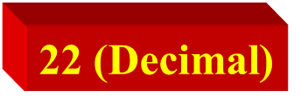
TEST
Convert Hexadecimal number A6 to Binary
Convert Hexadecimal number 16 to Decimal
Convert Decimal 63 to Hexadecimal
Convert Decimal 41.915 to Binary
Convert hexadecimal 7FD6 to Octal
1010 0110 (Binary)
3F (Hexadecimal)
101001.11101
77726

Slide 28
Takeaway
Digital computers are implemented via logic circuits and thus represent all numbers in binary (base 2).
We (humans) often write numbers as decimal and hexadecimal for convenience, so need to be able to convert to binary and back (to understand what computer is doing!).

Slide 29
Representation of Unsigned and Signed Integers
Are the negative numbers just numbers with a minus sign in the front? This is probably true…but there are issues to represent negative numbers in computing systems
Common schemas:
Sign-magnitude
Complementary representations:
1’s complement
2’s complement – most common & important

Slide 30
One’s complement
For example, in 8-bit one’s complement,
positive 3 is: 00000011
Negative 3 is: 11111100
In one’s complement, as with signed magnitude, negative values are indicated by a 1 in the high order bit.
Complement systems are useful because they eliminate the need for subtraction. The difference of two values is found by adding the minuend to the complement of the subtrahend.

Slide 31
Two’s Complement Representation
Step 1: First complement all the bits (that is find one’s complement) Make all 1s as 0s and all 0s as 1s
Step 2:Then perform increment by 1 Add 0001 b

Slide 32
Signed Numbers
Range of Values
Total combinations = 2^{n}
2’s complement form:
– (2^{n – 1}) to + (2^{n – 1} – 1)
Range for 8 bit number: n = 8 -(2⁸⁻¹) = -2⁷ = -128 minimum +(2⁸⁻¹) – 1 = +2⁷ - 1 = +127 maximum
Total combination of numbers is 2⁸ = 256.

Slide 33
WHAT IS A BINARY CODE ?
In the coding, when numbers, letters or words are represented by a specific group of symbols, it is said that the number, letter or word is being encoded.
The group of symbols is called as a code. The digital data is represented, stored and transmitted as group of binary bits. This group is also called as binary code. The binary code is represented by the number as well as alphanumeric letter.

Slide 34
Classification of Binary Codes
Weighted Codes
Non-Weighted Codes
Reflective Codes
Sequential Codes
Alphanumeric Codes
Error Detecting and Correcting Codes

Slide 35
CODE
Weighted and Non-Weighted Code
In weighted code, each digit represents specific weight.
Binary code has a weight 8 4 2 1
In non-weighted code weight is not assigned to position.
Excess 3 and Gray Codes.

Slide 36
Type of Codes
Binary - follows 8,4,2,1
Example – decimal 12 – Binary 1100
BCD – Binary Coded Decimal – each digit of decimal number is represented by a group of bits. Follows 8,4,2,1.
Example – decimal 12 – BCD 0001 0010
Excess -3 Code – derived from BCD code. Excess -3 is calculated by adding 3 to each BCD code. It is non weighted and sequential code.
Example BCD 12 – 0001 0010 its Excess -3 code is – 0100 0101
Gray Code

Slide 37
Codes and their conversions
Gray Code
Gray code is a code where only one bit changes at a time while traversing from 0 to any decimal number in sequence.
Gray Code is nonweighted and cyclic code
Not arithmetic code
Optical shaft encoders for disk to reduce errors

Slide 38
Binary to Gray Code Conversion
Copy the MSB bit as it is
Perform EX-OR operation between previous and current bit and write the result
Repeat the step 2 for all bits
Example – Binary 1011
1 , (1 EX-OR 0) , ( 0 EX-OR 1), (1 EX-OR 1)
1, 1, 1, 0

Slide 39
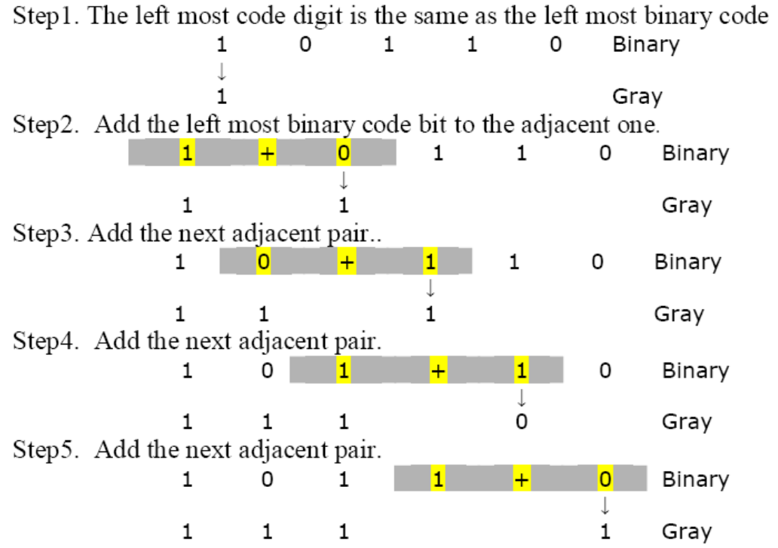
Binary to Gray Code Conversion

Slide 40
Gary to Binary Code Conversion
MSB of binary is set to the MSB of Gray code
Going from left to right, add the binary bit to the next Gray code bit. Discard carries.
Example. Convert 11011 to binary
MSB of Gray Code is 1, so set the MSB of the binary number to 1.
1 1 0 1 1 Gray Code
+
+
+
+
1 Binary
0
0
1
0

Slide 41

4 Bit Binary To Gray Code Conversion:
Decimal Value | INPUT (BINARY CODE) |  |  |  | OUTPUT (GRAY CODE)
 | B₃ | B₂ | B₁ | B₀ | G₃ | G₂ | G₁ | G₀
0 | 0 | 0 | 0 | 0 | 0 | 0 | 0 | 0
1 | 0 | 0 | 0 | 1 | 0 | 0 | 0 | 1
2 | 0 | 0 | 1 | 0 | 0 | 0 | 1 | 1
3 | 0 | 0 | 1 | 1 | 0 | 0 | 1 | 0
4 | 0 | 1 | 0 | 0 | 0 | 1 | 1 | 0
5 | 0 | 1 | 0 | 1 | 0 | 1 | 1 | 1
6 | 0 | 1 | 1 | 0 | 0 | 1 | 0 | 1
7 | 0 | 1 | 1 | 1 | 0 | 1 | 0 | 0
8 | 1 | 0 | 0 | 0 | 1 | 1 | 0 | 0
9 | 1 | 0 | 0 | 1 | 1 | 1 | 0 | 1
10 | 1 | 0 | 1 | 0 | 1 | 1 | 1 | 1
11 | 1 | 0 | 1 | 1 | 1 | 1 | 1 | 0
12 | 1 | 1 | 0 | 0 | 1 | 0 | 1 | 0
13 | 1 | 1 | 0 | 1 | 1 | 0 | 1 | 1
14 | 1 | 1 | 1 | 0 | 1 | 0 | 0 | 1
15 | 1 | 1 | 1 | 1 | 1 | 0 | 0 | 0

Slide 42
Sign Magnitude 1’s Complement 2’s Complement

Slide 43
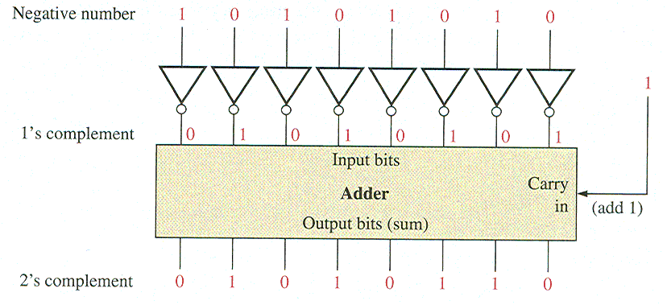
Terminology: One’s-Complement and Two’s-Complement
The one’s-complement of a binary number is the binary number that you get when you invert each bit.
Example: What is the one’s-complement of 10101010?
The two’s-complement of a binary number is the binary number that you get when you invert each bit and then add 1 to the result.
Example: What is the two’s-complement of 10101010?
Notes:
43
Do Practice Questions 4 and 5.

Slide 44
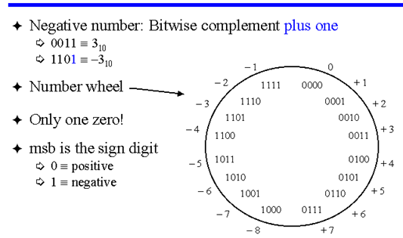
Twos Complement Representation

Slide 45
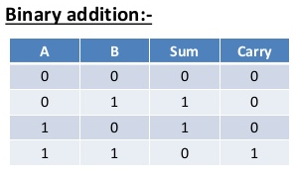
Binary Arithmetic
If addition is unsinged –keep on adding from LSB to MSB
In case of Signed Numbers – Sign bit and Concept of Sign bit extension need to be used.

Slide 46
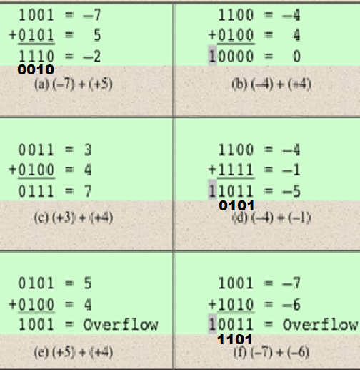
Integer Arithmetic: Addition
+7 = 0111
2’s complement of +7= 1001
+4 = 0100
2’s complement of +4= 1100
+1 = 0001
2’s complement of +1= 1111
+6 = 0110
2’s complement of +6= 1010
OVERFLOW RULE:
If two numbers are added, and they are both positive or both negative, then overflow occurs if and only if the result has the opposite sign.
If A and B are of opposite sign, then overflow cannot occur.

Slide 47
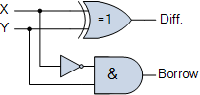
Binary Subtraction
Symbol | Truth Table
 | Y | X | DIFFERENCE | BORROW
 | 0 | 0 | 0 | 0
 | 0 | 1 | 1 | 0
 | 1 | 0 | 1 | 1
 | 1 | 1 | 0 | 0

Slide 48
Binary Subtraction
Negate a number (by taking its 2’s-complement).
Add binary numbers.
Notes:
48

Slide 49
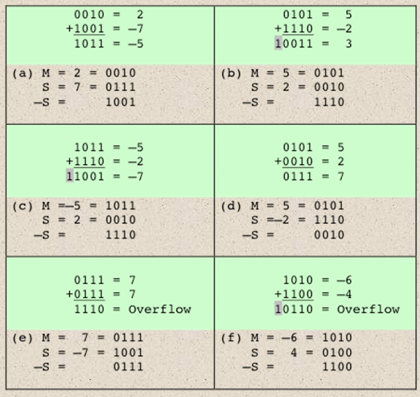
Subtraction
SUBTRACTION RULE: a - b = a + (-b)
To subtract one number (Subtrahend) from another (Minuend), take the twos complement (negation) of the subtrahend and add it to the minuend.

Slide 50
Multiplication (binary)
It’s interesting to note that binary multiplication is a sequence of shifts and adds of the first term (depending on the bits in the second term.
110100 is missing here because the corresponding bit in the second terms is 0.

Slide 51
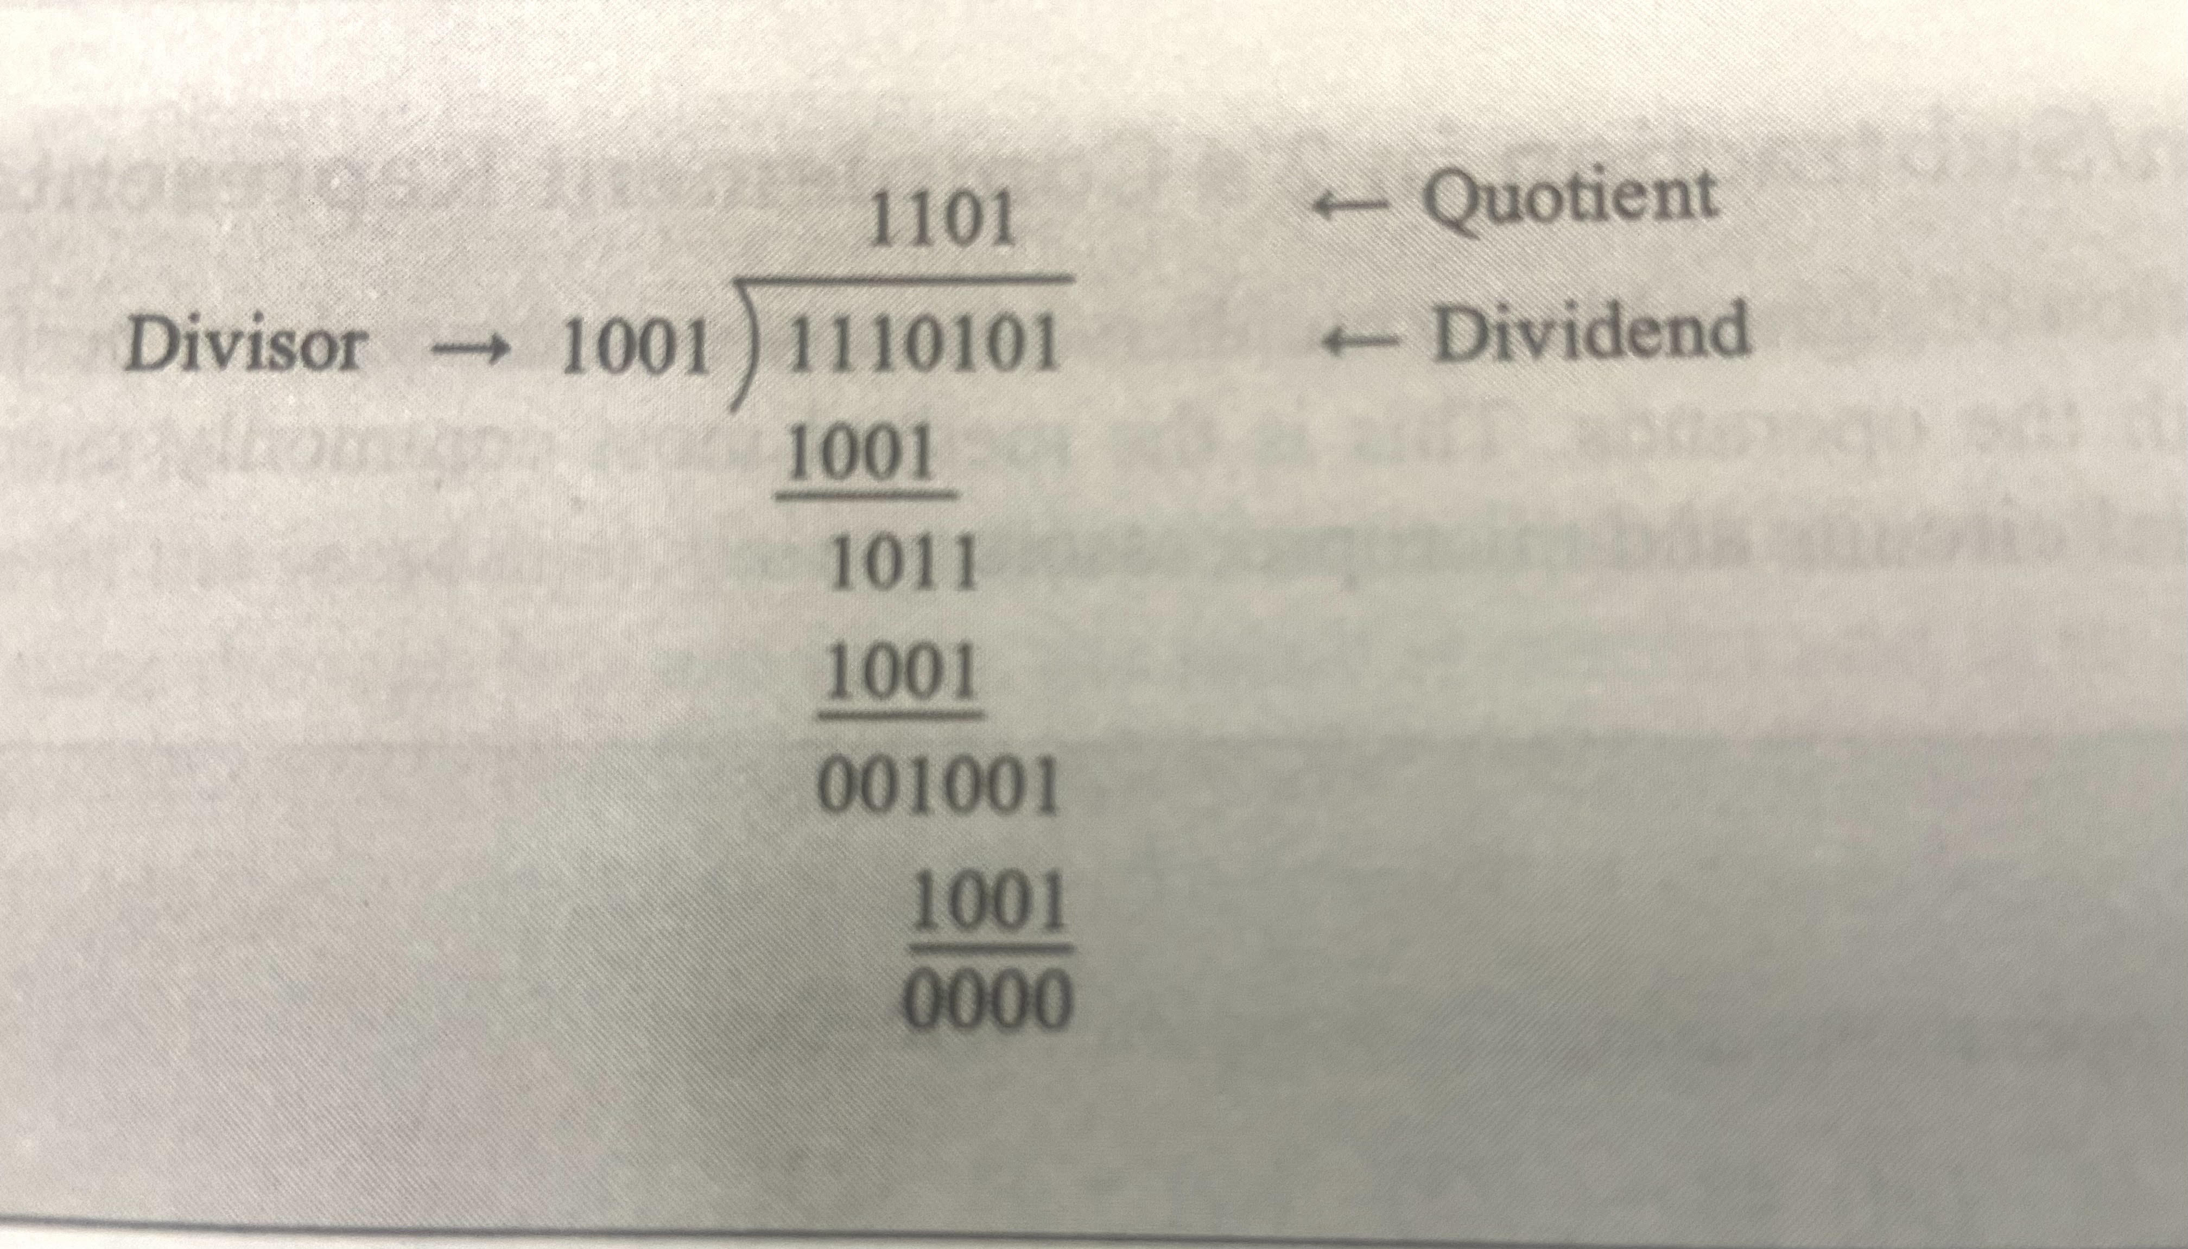
Binary Division

Slide 52
Boolean Logic Gates (Building Blocks for Digital Circuits ) (Because Switches are Hard to Work With)
“Logic gates” are better digital circuit building blocks than switches (transistors), Why?...

Slide 53
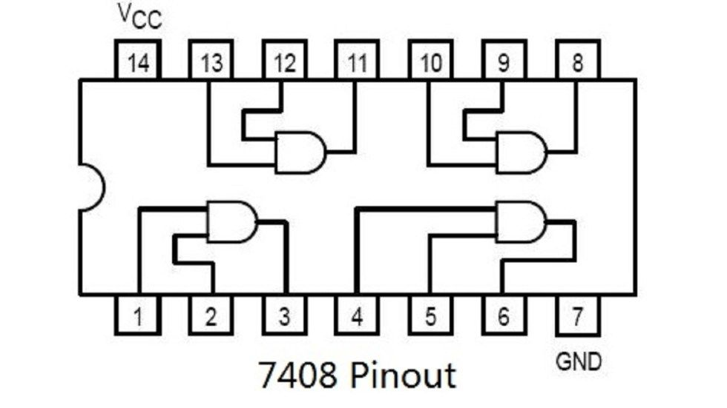
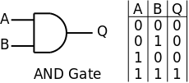
Logic Gates
AND Gate

Slide 54
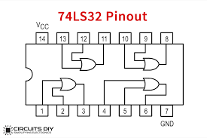
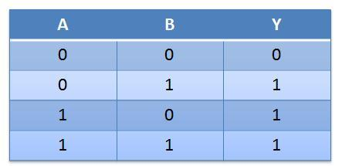
OR Gate
OR Gate

Slide 55
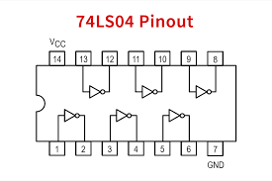
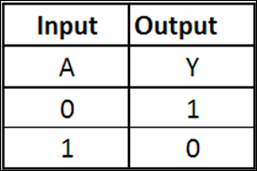
NOT gate
NOT Gate

Slide 56
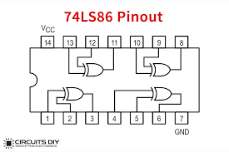
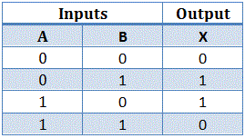
EX-OR

Slide 57
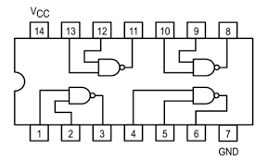
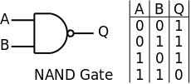
NAND Gate
NAND Gate IC 7400

Slide 58
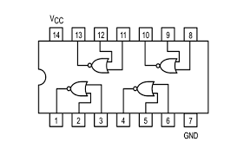
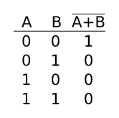
NOR Gate
NOR Gate IC 7402

Slide 59
Boolean Algebra Terminology
English Mathematician George Boole develop rules for manipulation of binary variables.
Variable - an arbitrary element of a Boolean Algebra is known as Variable. It can have either value 0 or 1.
Constant – it can have fixed value as 0 or 1
Complement – is represented with the “bar over the letter,”
Literal – each occurrence of a variable in Boolean Function in complemented or complemented way is called as a Literal
Boolean Function- Boolean expressions are constructed by connecting variable, constant in Boolean operations which, altogether describes Boolean function.

Slide 60
Boolean Algebra - Properties
Closure Property –
With respect to + Operator – When two binary elements are operated with + operator the result is a unique binary element.
With respect to . Operator – When two binary elements are operated with . (dot) operator the result is a unique binary element.
Identity Property
Cumulative Property
Distributive Property
Complement Property
Idempotency Property (Sameness)
Absorption Property
Involution Property

Slide 61
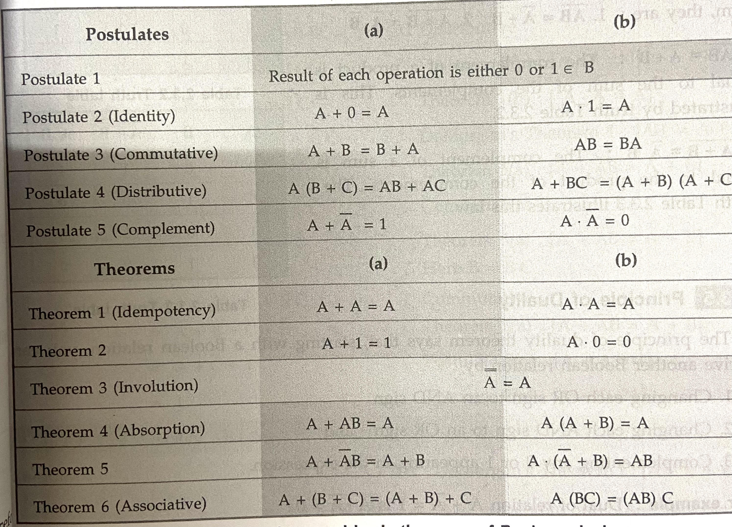

Slide 62


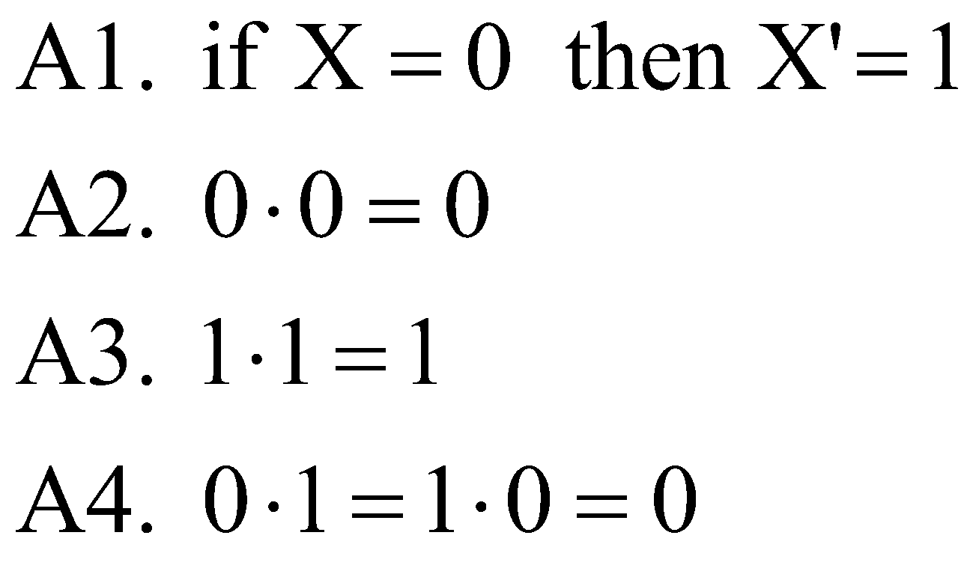
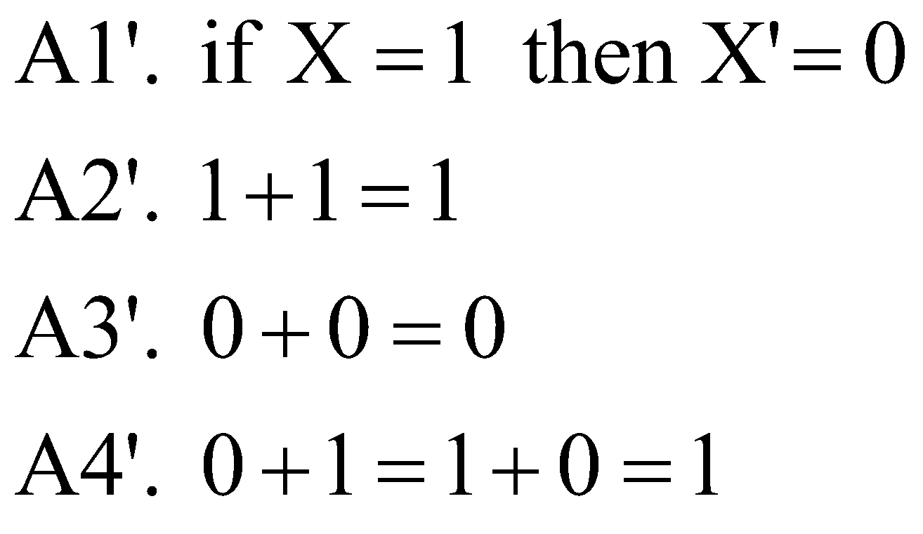

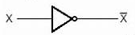


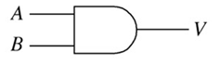
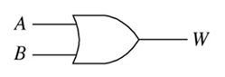
Boolean Algebra Postulates/Rules
Postulates of a mathematical / binary system: Minimal set of basic definitions from which all other information can be derived

Slide 63


Useful Properties of Boolean Algebra
Operations with 0 and 1:
1. X + 0 = X 1D. X • 1 = X
2. X + 1 = 1 2D. X • 0 = 0
Idempotent Theorem:
3. X + X = X 3D. X • X = X
Involution Theorem:
4. (X' )' = X
Theorem of Complementarity:
5. X + X' = 1 5D. X • X' = 0
Idempotent Theorem:
3. X + X = X

Slide 64
Useful Properties of Boolean Algebra
Commutative law:
6. X + Y = Y + X 6D. X • Y = Y • X
Associative law:
7. (X + Y) + Z = X + (Y + Z) 7D. (X Y)Z = X(Y Z) = X Y Z
= X + Y + Z
Distributive law:
8. X(Y + Z) = XY + XZ 8D. X + YZ = (X + Y)(X + Z)
Simplification theorems:
9. XY + XY' = X 9D. (X + Y)(X + Y' ) = X
10. X + XY = X 10D. X(X + Y) = X
11. (X + Y' )Y = XY 11D. XY' + Y = X + Y

Slide 65
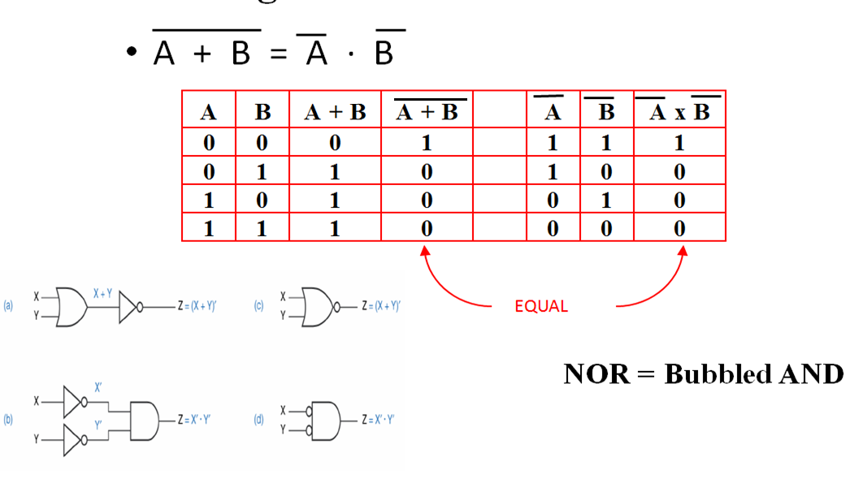
DeMorgan’s Theorem 1

Slide 66
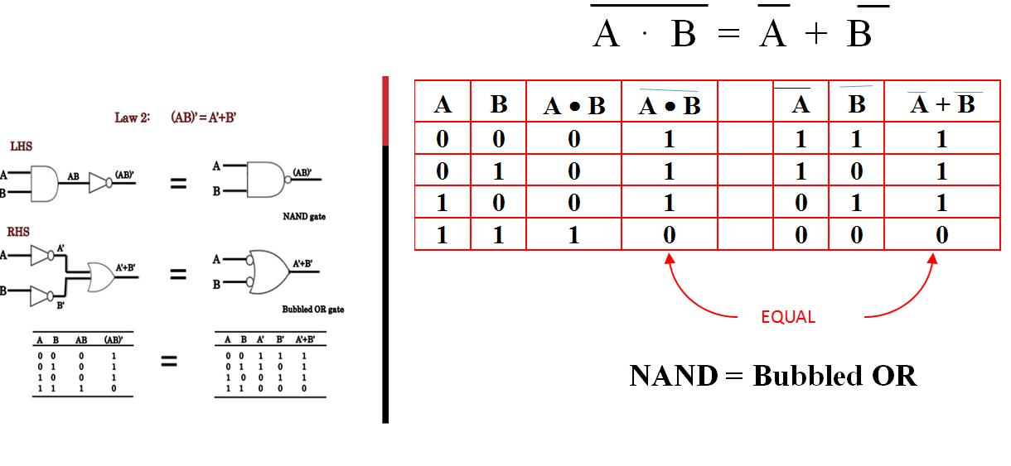
DeMorgan’s Theorem 2

Slide 67
SOP & POS

Slide 68
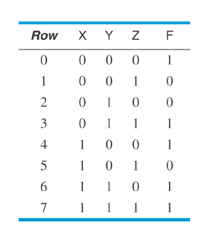
Representations of Logic Functions
Truth Tables Table that shows the output value for each combination of the inputs. The truth table for an n-variable (n-inputs) logic function has 2^{n} rows.
Algebraic expressions
Karnaugh Maps

Slide 69
Common Terminology
Literal The appearance of a variable or its complement
Product Term
One or more literals connected by AND operators
Sum Term
One or more literals connected by OR operators

Slide 70
Common Terminology(cnt’d)

Slide 71
Values of logic variables and logic functions are in binary form( 1 and 0).
Any logic function can be expressed in the forms of
1. Sum of Products form (SOP)
Y= AB + AC’ + BC------------SOP
Product terms: AB, AC’, BC [AND Gate Z = XY ]
Here Summation Terms : 2 terms [OR Gate Z = X + Y ]
ORing of ANDs

Slide 72
Values of logic variables and logic functions are in binary form( 1 and 0).
Any logic function can be expressed in the forms of
2. Product of Sums form (POS)
Y= (A +C)(B + C’)-----------POS
Sum Terms: A+C , B+C’ [OR Gate Z = X + Y ]
Here Product Terms: 1 [AND Gate Z = XY ]
ANDing of ORs

Slide 73
Standard Representations for Logic Functions
Canonical Normal Form
Standard form for Boolean expression that provide a unique signature
If each term in SOP and POS forms contains all the literals then these are known as canonical SOP and POS respectively.
Each individual term in canonical SOP form is called as minterm (mo, m1, m2……)
Each individual term in canonical POS form is called as as maxterm (M0, M1, M2……)

Slide 74
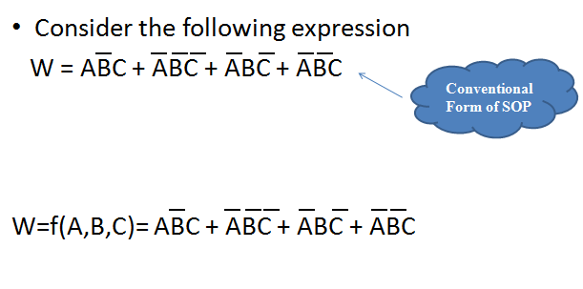
Canonical or Conventional form

Slide 75
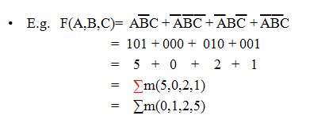
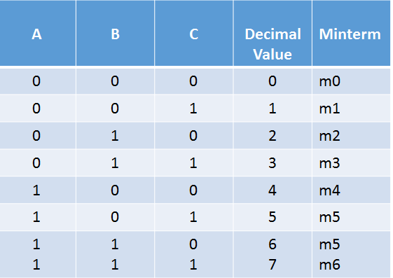
Summation Form of Expression --SOP
In this case we substitute a “1” for all positive variables & a “0” for all inverted
Ex: A = 1 and A’ or A = 0 ; B=1 and B’ = 0 and C=1 and C’ = 0
Canonical Form and Summation form
Minterms

Slide 76
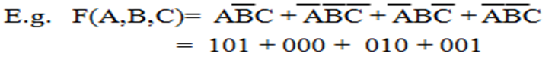
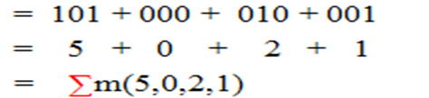
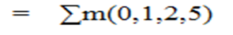
Conversion Process – Canonical form to summation form
It takes 3 steps:
Each minterm is converted into it’s binary equivalent.
2. Each minterm is converted from binary to decimal.
3. Finally the min terms are placed in ascending order

Slide 77
Advantages of Summation form
Useful for implementation in Programmable Logic
Very long & complex expressions can be easily described
Useful for implementation with hardware devices

Slide 78
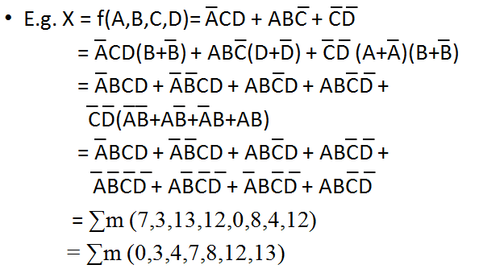
Conversion from Conventional to Summation Form

Slide 79
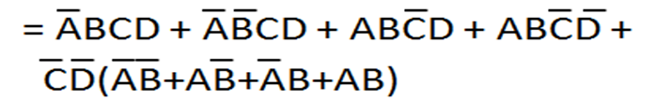
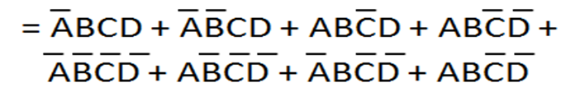
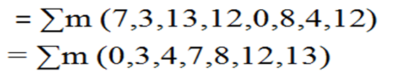
Conversion from Conventional to Summation Form

Slide 80
Conversion from Conventional to Summation Form

Slide 81
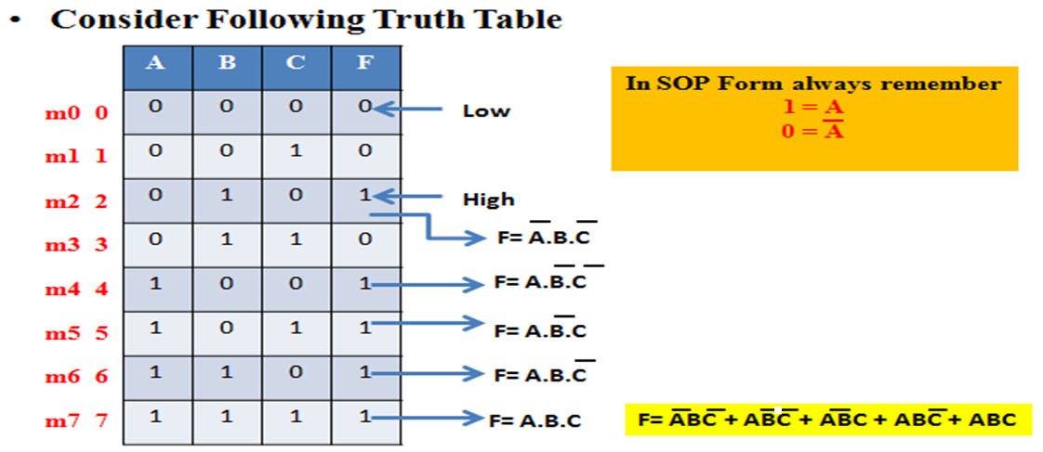

Slide 82
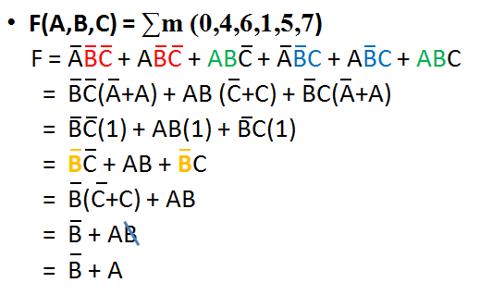



Practice Examples(Contd..) {Law of distribution: A+BC = (A+B)(A+C)} so B’ + AB = (B’ +A) (B’ + B) = B’ + A}

Slide 83

Practice Examples(Contd..) 010, 100, 101, 110, 111

Slide 84
Practice Examples(Contd..) A’X +A = (A+A’)(A+X)= A+X = A + BC’

Slide 85

Practice Examples(Contd..)
CSE203 Digital Electronics and Logic Design

Slide 86
Practice Examples(Contd..)
m0 = A’B’
m1 = A’B
m2 = AB’
m3 = AB
CSE203 Digital Electronics and Logic Design

Slide 87
Product of Sum (POS)
It is a Conjunctive Normal form or Maxterm Expansion
E.g.
(A+B) (C+D)
(A OR B) AND (C OR D)
i.e. AND of OR terms

Slide 88

POS Contd..
A+B+C
A+B+C’
A+B’+C’

Slide 89

POS (Contd..)

Slide 90

POS (Contd..)

Slide 91

Practice Example

Slide 92
Practice Example

Slide 93

Practice Example (Contd..)
POS Representation
Y = $π$(M1, M3)
Y= $π$M(1,3)
SOP Representation
Y=∑m(0,2)

Slide 94
Practice Example (Contd..)
For following truth table find minterm & maxterm i.e. SOP & POS forms
A | B | C | F
0 | 0 | 0 | 1
0 | 0 | 1 | 0
0 | 1 | 0 | 1
0 | 1 | 1 | 1
1 | 0 | 0 | 0
1 | 0 | 1 | 0
1 | 1 | 0 | 1
1 | 1 | 1 | 1
Y (A,B,C) = ∑m(0,2,3,6,7)
m0 0
M1 1
m2 2
Y (A,B,C) = πM(1,4,5)
m3 3
M4 4
M5 5
m6 6
m7 7

Slide 95
Practice Example (Contd..)
For following truth table find summation & product forms i.e. SOP & POS forms
A | B | C | F
0 | 0 | 0 | 1
0 | 0 | 1 | 0
0 | 1 | 0 | 1
0 | 1 | 1 | 1
1 | 0 | 0 | 0
1 | 0 | 1 | 0
1 | 1 | 0 | 1
1 | 1 | 1 | 1
Y (A,B,C) = ∑m(0,2,3,6,7)
m0 0
M1 1
m2 2
Y (A,B,C) = πM(1,4,5)
m3 3
M4 4
M5 5
m6 6
m7 7

Slide 96

Practice Example (Contd..)

Slide 97
Practice Example (Contd..)

Slide 98

Practice Example (Contd..)

Slide 99





Practice Example (Contd..)
Y(A,B,C) = πM(1,4,5)
πM(001,100,101)
= (A+B+C’)(A’+B+C)(A’+B+C’)
Consider A’+B = X and C = Y and C’=Z

Slide 100
Karnaugh Map
K-MAP

Slide 101
Introduction
Expression reduction through basic rules of Boolean algebra is time consuming for higher variables.
Solution is K-Map - graphical method
A Karnaugh map (K-Map) is a pictorial method used to minimize Boolean expression without having to use Boolean algebra theorems & equation manipulation
It is a special version of truth table
Using K-Map, expressions with 2 to 4 variables are easily minimized

Slide 102


2 – Variables K- Map

Slide 103
3 – Variables K- Map
BC
00 01 11 10
A
0
1
0 | 1 | 3 | 2
4 | 5 | 7 | 6
BC
BC
00 01 11 10
00 01 11 10
A
A
0
1
A’B’C’ | A’B’C | A’BC | A’BC’
AB’C’ | AB’C | ABC | ABC’
0
1
A+B+C | A+B+C’ | A+B’+C’ | A+B’+C
A’+B+C | A’+B+C’ | A’+B’+C’ | A’+B’+C
SOP Form
POS Form

Slide 104

4 – Variables K- Map
CD
00 01 11 10
AB
00
01
11
10
0 | 1 | 3 | 2
4 | 5 | 7 | 6
12 | 13 | 15 | 14
8 | 9 | 11 | 10
CD
00 01 11 10
AB
A’B’C’D’ | A’B’C’D | A’B’CD | A’B’CD’
A’BC’D’ | A’BC’D | A’BCD | A’BCD’
ABC’D’ | ABC’D | ABCD | ABCD’
AB’C’D’ | AB’C’D | AB’CD | AB’CD’
A+B+C+D | A+B+C+D’ | A+B+C’+D’ | A+B+C’+D
A+B’+C+D | A+B’+C+D’ | A+B’+C’+D’ | A+B’+C’+D
A’+B’+C+D | A’+B’+C+D’ | A’+B’+C’+D’ | A’+B’+C’+D
A’+B+C+D | A’+B+C+D’ | A’+B+C’+D’ | A’+B+C’+D
00
01
11
10
SOP Form
POS Form

Slide 105


Practice Examples
m0 | m1
m2 | m3

Slide 106



Practice Examples(Contd..)
Way 1
Way 2

Slide 107


Practice example
F = A + BC’
Y=A+BC’

Slide 108

Practice Example
Minterms: 0,2,1
A’
Y = A’ + B’
B’

Slide 109

Example (Contd..)
Minterms: 0,2,6,3,7,5
BC
00
01
11
10
A
0
1 |  | 1 | 1
 | 1 | 1 | 1
1
Z = A’C’ + AC + B

Slide 110
Four Adjacent ones
A’D’
CD
AB
00
01
11
10
00
0 1 | 4 | 12 | 8 1
1 1 | 5 | 13 | 9 1
3 1 | 7 1 | 15 1 | 11 1
2 | 6 | 14 | 10
01
11
AB
10
Y = A’D’ + AB

Slide 111


Practice Example

Slide 112

Example
What is the solution of k map if all entries are 1?. We want SOP form solution.

Slide 113

What is the solution of k map if all entries are 1?. We want SOP form solution.
CD
00 01 11 10
AB
00
01
11
10
0 | 1 | 3 | 2
4 | 5 | 7 | 6
12 | 13 | 15 | 14
8 | 9 | 11 | 10
Y (A,B) = A’B’+ A’B +AB’+ AB
Y = A’(B’+B) + A B’+B)
Y = A’+ A
Y = 1

Slide 114

Folding K map in horizontal direction

Slide 115


Folding K map only in horizontal direction
Folding K map only in Vertical direction

Slide 116

Folding K map in both horizontal as well as vertical direction

Slide 117

Folding K map - AN EXAMPLE

Slide 118

K map for POS form Boolean expressions

Slide 119

POS form – k map simplification

Slide 120

POS form – k map simplification

Slide 121

POS form – k map simplification

Slide 122
Prime Implicant
The process of simplification involves grouping of Minterms & identifying Prime Implicants (PI) & Essential Prime Implicants (EPI)
Prime implicant is a group of ones (minterms) that cannot be combined with any other ones (minterms) or groups
EPI is PI, in which one or more minterms are unique
i.e. it contain atleast one minterm which is not contained in any other PI

Slide 123
Prime Implicant (Contd..)
AB
C
00
01
11
10
0
1
1 |  | 1
1
BA
DC
00
01
11
10
00
 |  | 1 | 1
1 |  |  | 1
 |  | 1 | 1
 |  |  | 1
Prime Implicant
01
11
10

Slide 124
Don’t Care Condition (X)
The K-Maps are simplified using either 1’s or 0’s, therefore we make the entries in the map for either 0 or 1
The cell which do not contain 1 are assumed to contain 0 & vice versa
This is not always true, since there are cases in which certain combinations of I/P variables do not matter

Slide 125
Don’t Care Condition (X)
In such a situation the designer has a flexibility & it is left to him whether to assume 0 or 1 as O/P for each of these combinations
This condition is known as Don’t Care Condition and can be represented on K-Map as a X mark in the corresponding cell
The X mark in a cell may be assumed to be a 1 or 0 depending upon which one leads to a simpler expression

Slide 126

Don’t Care Condition (X)
Without Considering don’t care conditions.
Y= AB’C
Assuming don’t care as 1.
Y=AC

Slide 127

Example

Slide 128

Example

Slide 129


Change in position of variable (Important to observe)

